Slide 1



Presentation on
E-farming Management System
IUBAT– International University of Business Agriculture and Technology

Slide 2
IUBAT- International University of
Business Agriculture
and Technology
Prepared By
Humira Cousary
ID: 18103310
Program: BCSE
Supervised By
Md. Muhyminul Haque
Lecturer,
Dept. of Computer Science & Engineering

Slide 3
Contents
Introduction
Organization Overview
Project Overview
Requirement Engineering
System Planning & Scheduling
Risk Management
Analysis and Designing
Project Demonstration
Future Work
Conclusion

Slide 4

Introduction
What is E-farming ?
What is the E-farming Management System?
What is the beneficial side of E-farming?
Why we use this system?

Slide 5

Organization Overview
Established in 2017 in Dhaka, Bangladesh.
web solution
software development
mobile application
graphic & multimedia
domain hosting
digital marketing service
Vision: “Make every youth skilled & employed.”

Slide 6
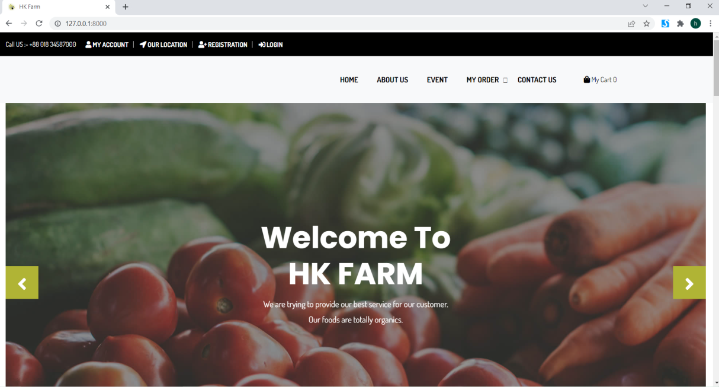
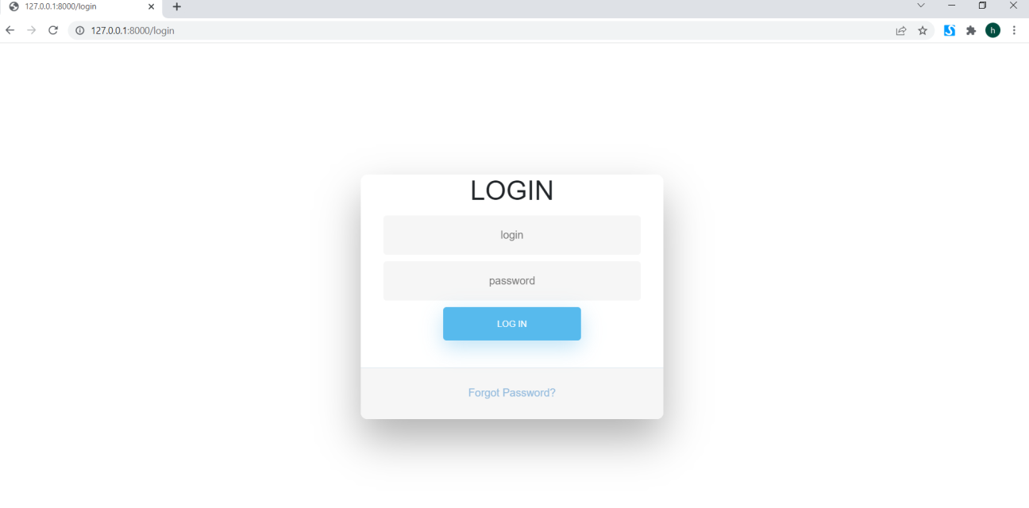
Project Overview
E-farming Management System is an easier process to maintain and selling goods door to door at any time.
User must be authenticated with his/her login details.

Slide 7
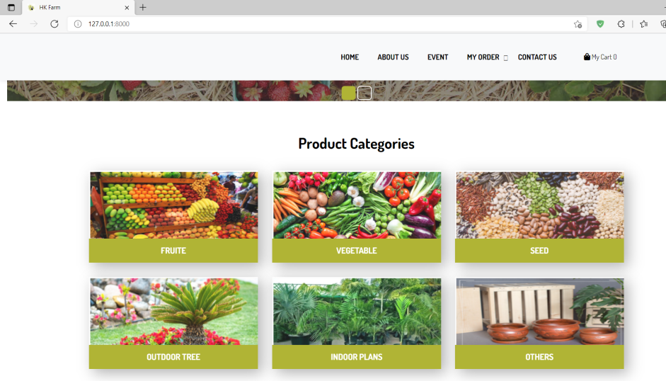
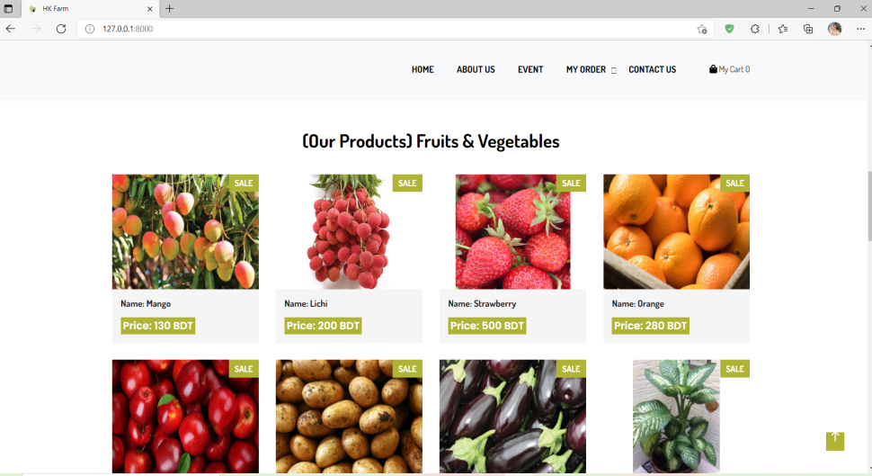
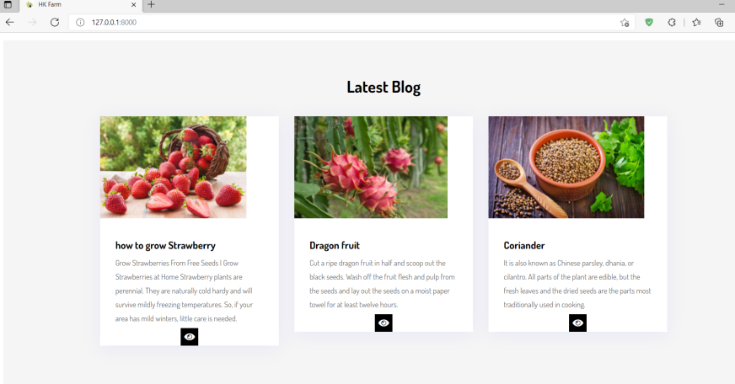
Project Overview Contd…
User can visit the website and select the category and products and get the information about the product.
User watch the blog and attend event which is organized by the farm.

Slide 8
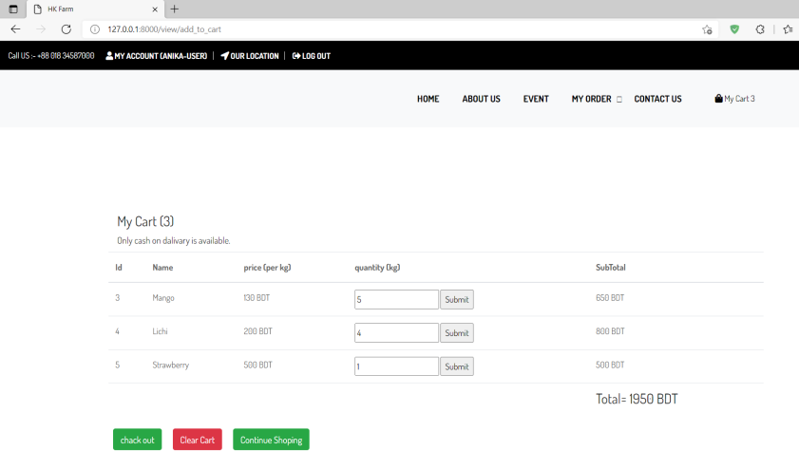
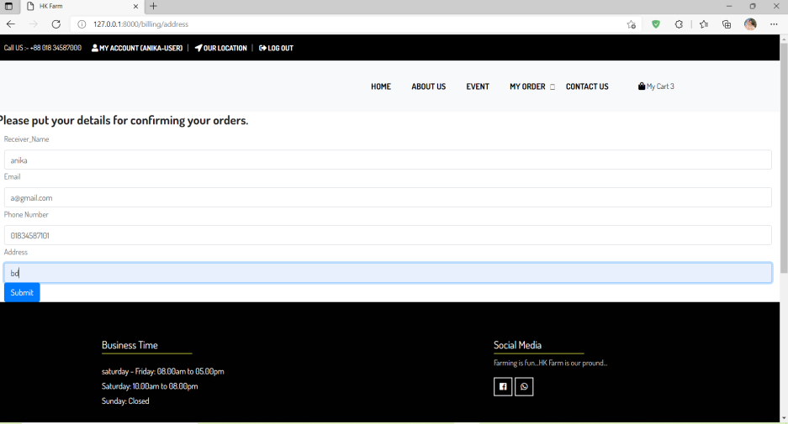
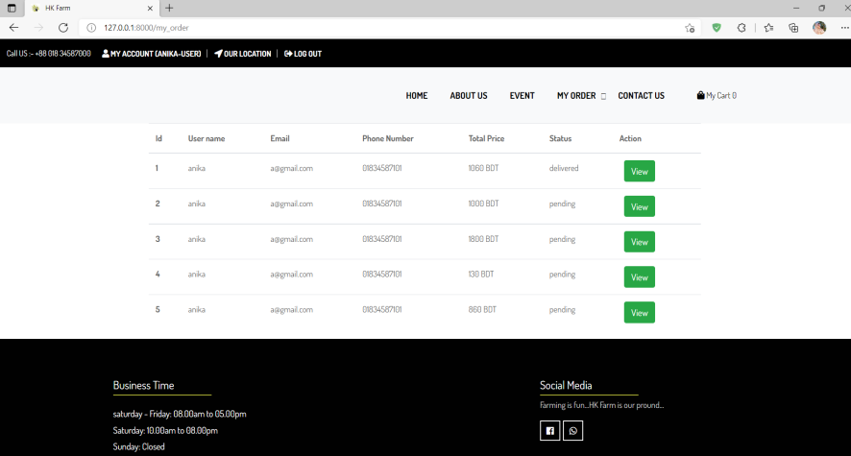
Project Overview Contd…
User can order their product what they need without any hassle.
The system will dynamically generate product price and quantity.
By one click they can placed their orders.
User will get the status about his/her order.

Slide 9
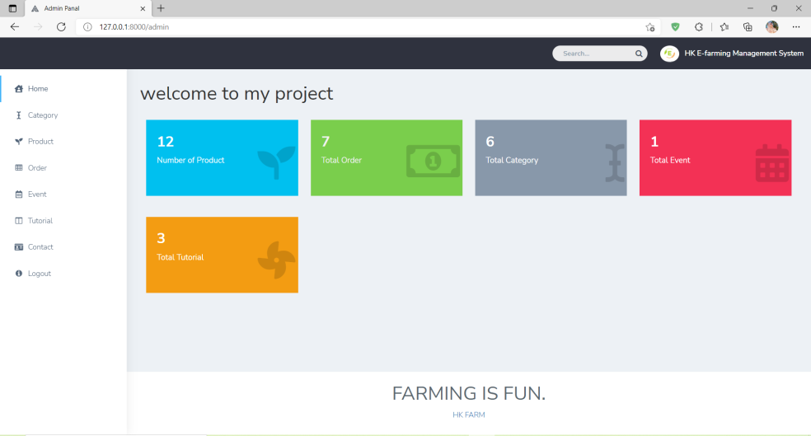
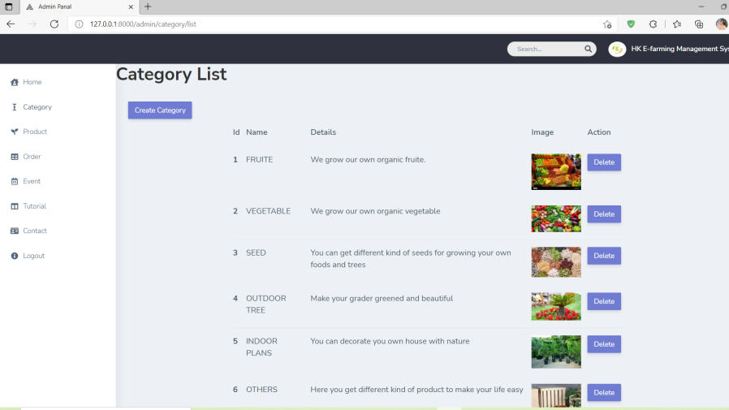
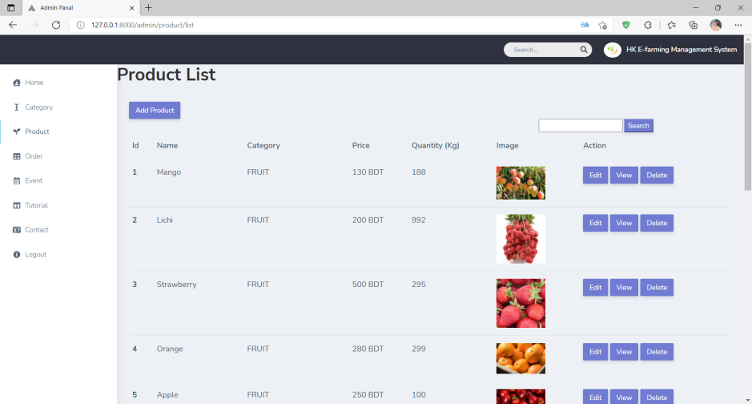
Project Overview Contd…
Admin can manage the whole system
Admin can add new category and product and manage them.

Slide 10
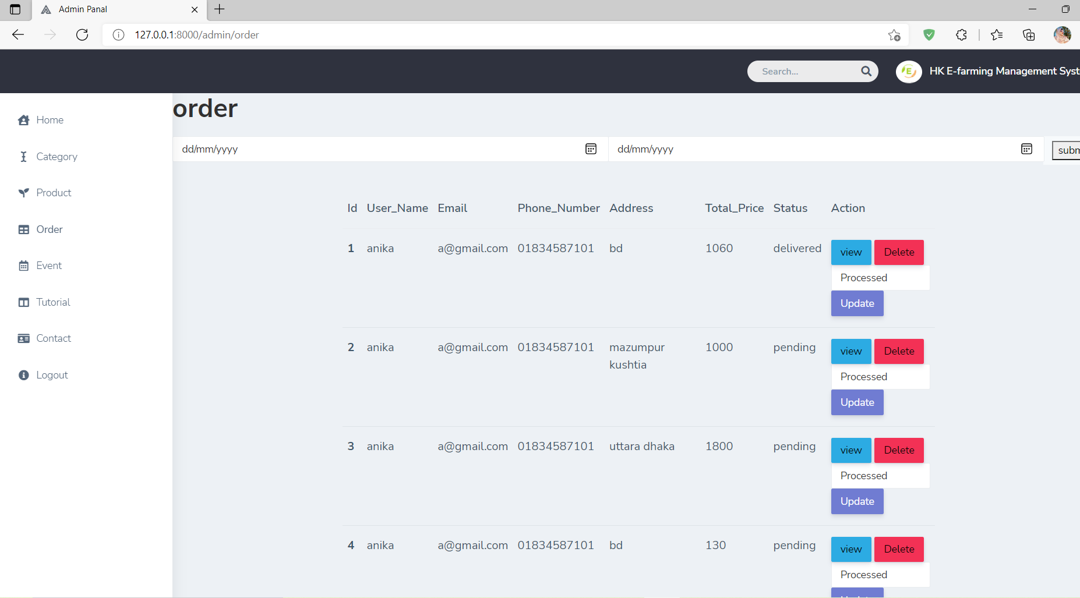
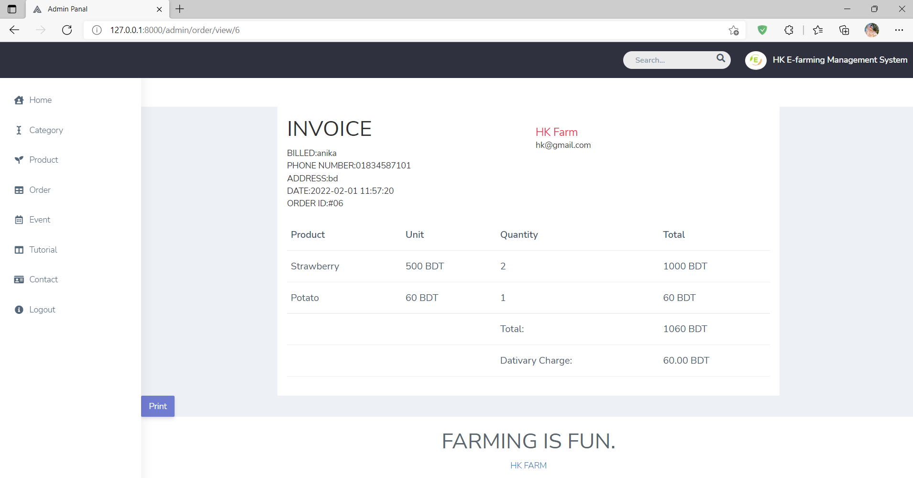
Project Overview Contd…
Admin also manage the order and change the order status.
Admin also make the bills.
Admin can filter the order.

Slide 11
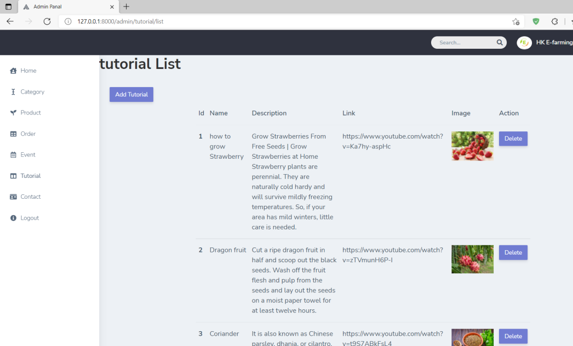
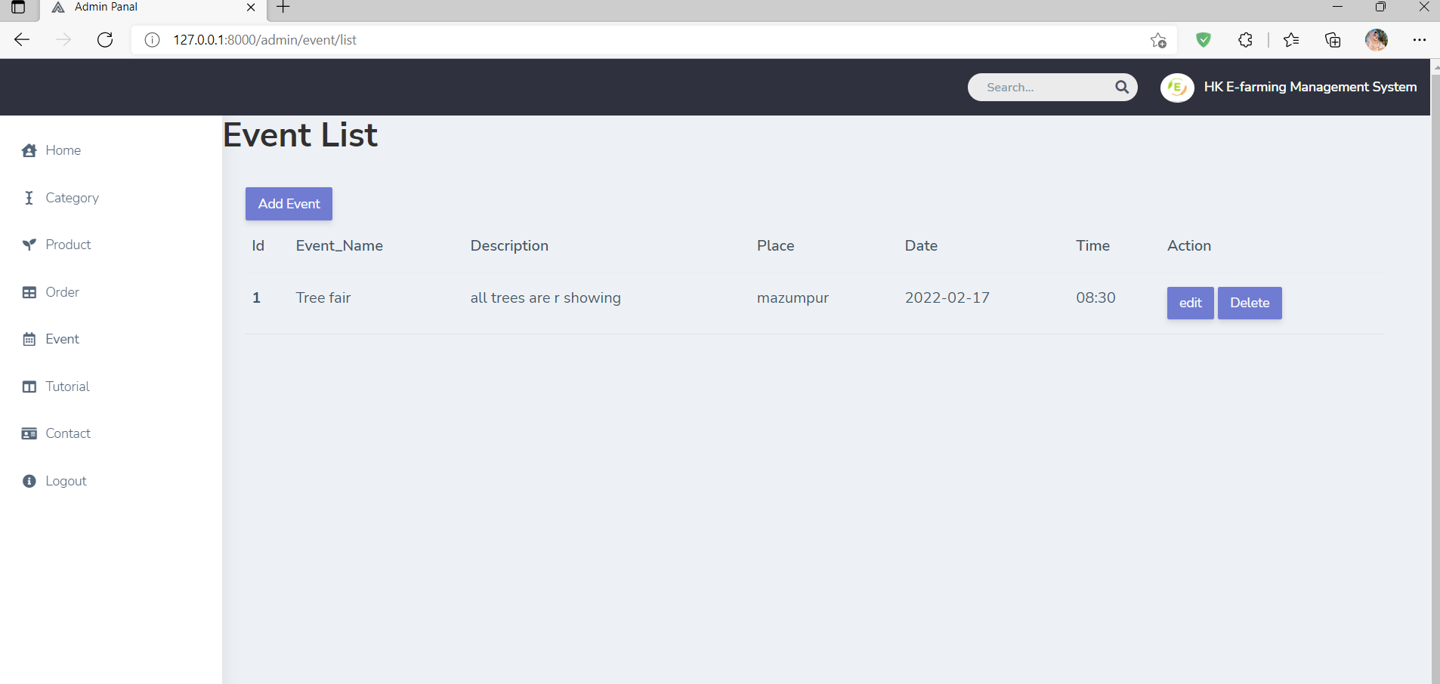
Project Overview Contd…
Admin can upload the blogs and manage the blogs.
Admin can arrange different type of events and also manage them.

Slide 12
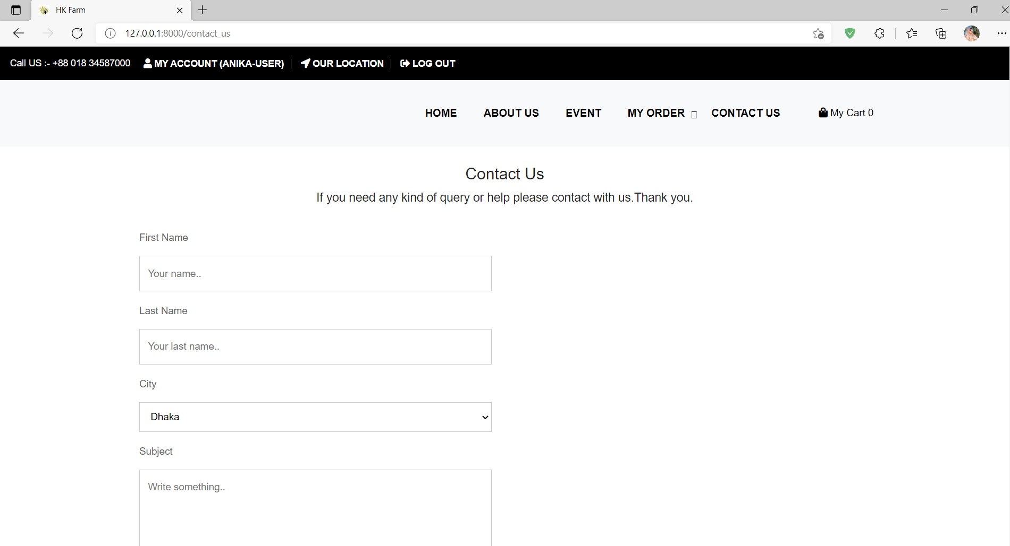
Project Overview Contd…
User can contact with the farmer for any kind of quire and takes help from them.
Admin also give feed back through mail or mobile.

Slide 13

Objectives
Provide an online based system for buying and selling fresh product.
To provide a user-friendly interface for the user and the farmer.
Provide a easier admin panel to manage the backend functionalities.
Provide s system which is more secure to authenticate both user and admin.
To helps farmer to improve there productivity and profitability.
To maintain sustainable production system.

Slide 14

System Benefits
Web based application
Can be accessed from anywhere by internet browser
Platform Independent
Faster and Full responsive
Roles based authorization system.
Secured with two step verification as well as multiple login detector

Slide 15
Process Model
Designing and developing
Build 1
Testing
implementing
Designing and developing
Build 2
Testing
implementing
Requirements
Designing and developing
Testing
implementing
Build 3
Figure: Iterative Process Model

Slide 16

Feasibility Study
Technical Feasibility
PHP 8.0
Laravel 8
MySQL
Economic Feasibility
Time Saving
Efficient cost
Operational Feasibility
Easy to operate
Easy to maintain

Slide 17

Requirement Engineering
User requirements
System requirements
Functional requirements
Non-Functional requirements

Slide 18

User Requirements
Admin
Admin manage category and product.
Admin can add, update, delete and view the category and product’s information.
Admin able to manage order and order status.
Admin able to make invoice and print it.
Admin can access every part of the software.
He able to update the blogs and also manage the blog.
He can arrange events and also manage the event arrangement.

Slide 19

User Requirements Contd…
User
User able to choice the categories and products
All authorized users can order product
and view the order status.
Allow the user to view information of available
products and others
Users are able to order the products through online.
Allow the user to contact for any quires.
Users can watch the blogs and events and they can register for it.

Slide 20

System Requirements
Checking Validity of Email and Password
If All Credentials are valid, User is authenticated
System can check Roles and Permissions for users and admin
Based on Role of Admin/Users can manage website and their panel

Slide 21
Functional Requirements
Admin
User
View all information
Add categories and products
Upload blogs and events
Update and delete items
Update and delete all information
Maintain the orders
Update the order status
Manage the user who want to contacted
Login
Logout
Login
See categories and products
Select the products and add to cart
Confirm the order.
View the order status.
Watch blogs and events
Registered themselves for the events
Logout

Slide 22
Non-Functional Requirements
Users have to login with their own password
Password will be encrypted
User name and password for admin, customer saved in the database for security purpose
Without admin, no one can view the dashboard area

Slide 23
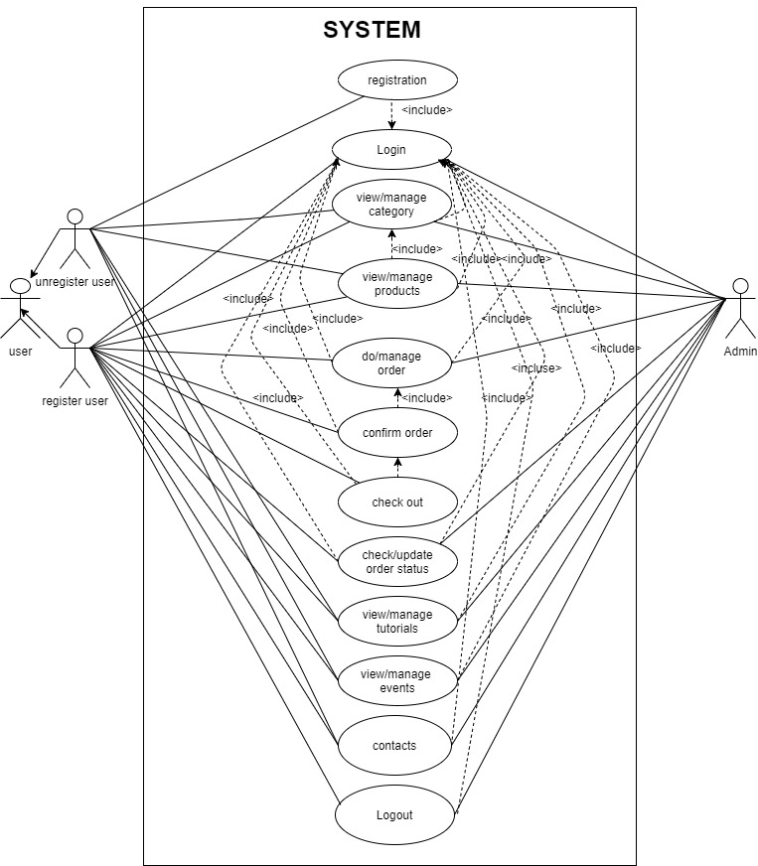
Use Case Diagram

Slide 24
System Planning and Scheduling
Functions of the Proposed System
Function Name | Synonym
Login | F1
Users Registration | F2
View Categories | F3
View Products | F4
Add to cart | F5
Confirm Order | F6
View the Order | F7
View Blogs | F8
Attend Events | F9
Can contact | F10
Logout | F11

Slide 25
System Planning and Scheduling Contd…
Function Point Estimation
Value Adjusted Factor (VAF) = 0.55 + (0.01*TDI)
=055 + (0.01*19)
=0.55+0.19
=0.74
Unadjusted Function Point (UFP) = UFP (transaction function) + UFP (data function)
= 32+51
= 83
Adjusted Function Point (AFP) count = UFP* VAF
=83*0.74
=61.42

Slide 26
System Planning and Scheduling Contd…
Effort Based Estimation

Slide 27
System Planning and Scheduling Contd…
Project Scheduling Chart
Time Activity | W1 | W2 | W3 | W4 | W5 | W6 | W7 | W8 | W9 | W10 | W11 | W12
Project offer info analysis
Planning
Analysis
Designing
Coding
Testing
Implementation

Slide 28
System Planning and Scheduling Contd…
Cost Estimation
Hardware cost
Software Cost
Name | Price
MS Office 2010 | 10500
Windows 10 | 11500
Total | 22000 BDT
Cost of a Laptop = 70000
Computer life = 1.5 years
Computer practice = 16 weeks = 4 months
Computer cost = (70000/18) x 4 x 2 = 31111.11 BDT

Slide 29
System Planning and Scheduling Contd…
Cost Estimation
Other Cost
Total Cost
Name | Price
Transport | 1200
House rent | 2000
Electric bill | 1500
Extra | 500
Total | 5200 BDT
Purpose | Amount
Salary | 85,300
Hardware | 31111.11
Software | 22000
Other | 5200
Total | 143611.11 BDT

Slide 30
Risk Management
The RMMM Plan
Risk Mitigation- Proactive planning for risk avoidance.
Risk Monitoring- Assessing whether predicted risks occur or not, ensuring preventive steps are being properly applied, collect information for future risk analysis, attempt to determine which risks caused which problem.
Risk Management- Actions to be taken in the event that mitigation steps have failed and the risk has become a live problem.

Slide 31
Risk Management Contd…
Project Risk
Project Risk (P01) | Date: 25-10-2021
Name | Change the requirement for project
Probability | Low (18%)
Impact | Marginal (2)
Description | Company may change their requirements
Mitigation & Monitoring | Requirements are redefined by the company due to time or business needs. Meeting should be occurred with the company on a regular basis. This ensures that the product we are producing solves a problem.
Management | An emergency meeting between both parties to identify new project requirements and goals.
Status | Not occur

Slide 32
Risk Management Contd…
Business Risk
Business Risk (B01) | Date: 20-10-2021
Name | Insufficient Budget
Probability | Moderate (35%)
Impact | Marginal (2)
Description | If the budget is low project might not complete.
Mitigation & Monitoring | The whole system should need the data server and it can be costly. We discover several alternative streaming services to cut back the budget risk
Management | Refinement in project goal. A new plan for regulate the budget.
Status | Problem resolved.

Slide 33
Risk Management Contd…
Technical Risk
Technical Risk (T01) | Date: 20-11-2021
Name | Lack of Experience
Probability | Low (20%)
Impact | Tolerable (3)
Description | Lack of members experience
Mitigation & Monitoring | The development cost of the software may increase by 20%. After Consulting with the System Analyst during the system analysis, design and testing phase of the software project.
Management | Though the implementation cost is increased by 20%, the project continuous to be feasible. Set appointment for formal meeting with the System Analyst.
Status | Not arise yet.

Slide 34
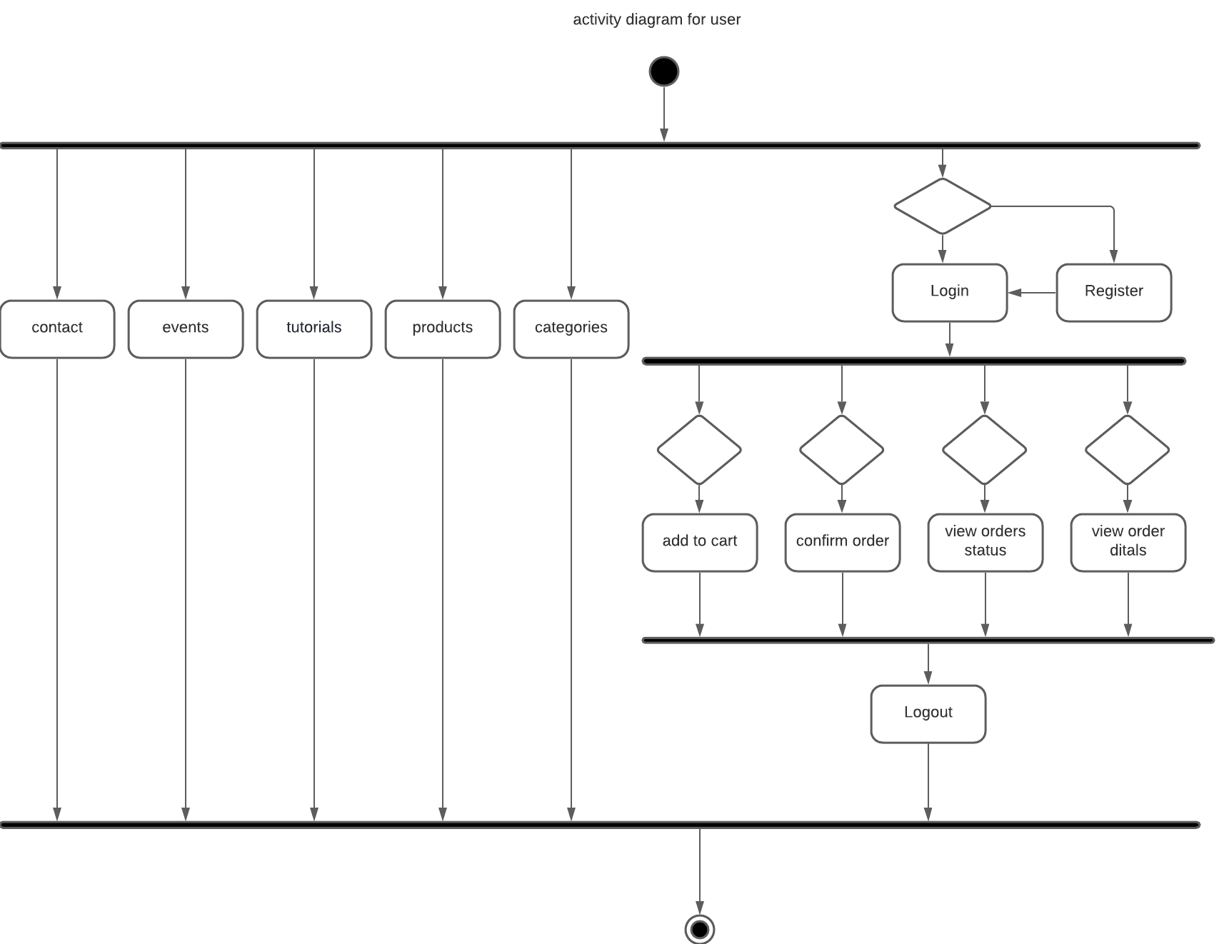
Analysis and Designing
Activity Diagram for User

Slide 35
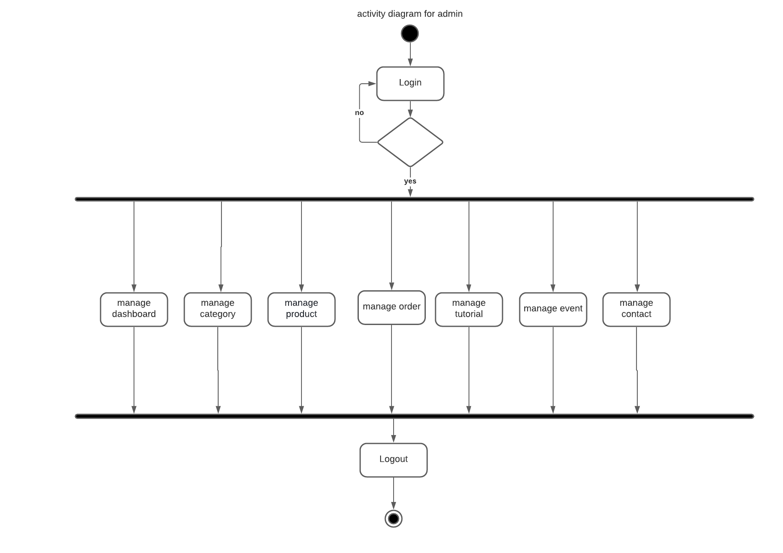
Analysis and Designing Contd…
Activity Diagram for Admin

Slide 36
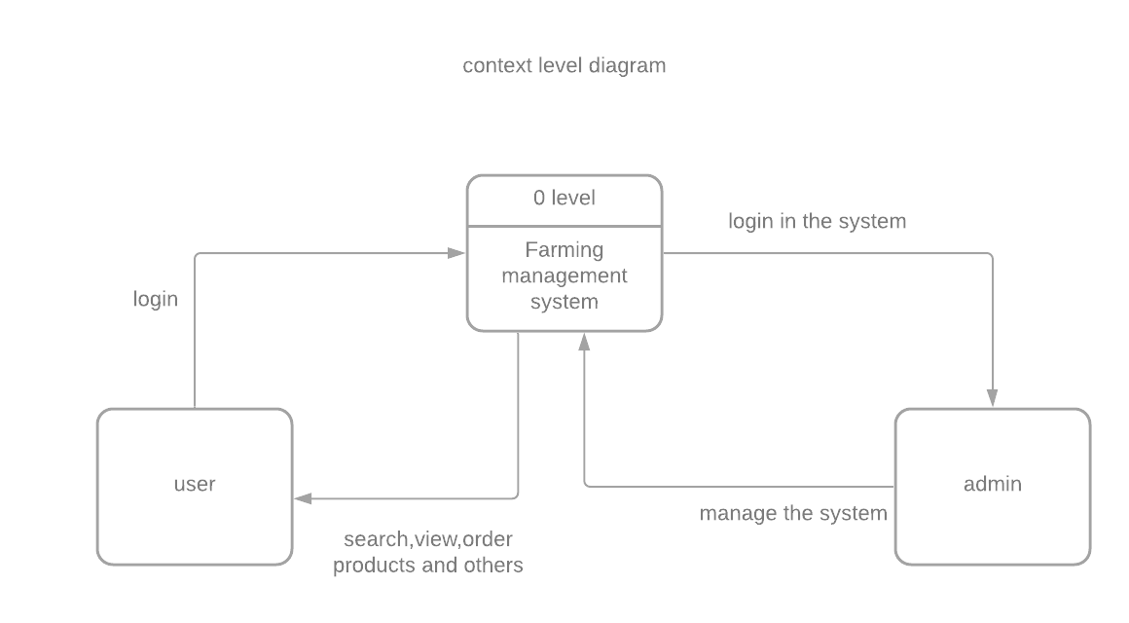
Analysis and Designing Contd…
Data Flow Diagram (DFD)
Level 0 (Context Level Diagram)

Slide 37
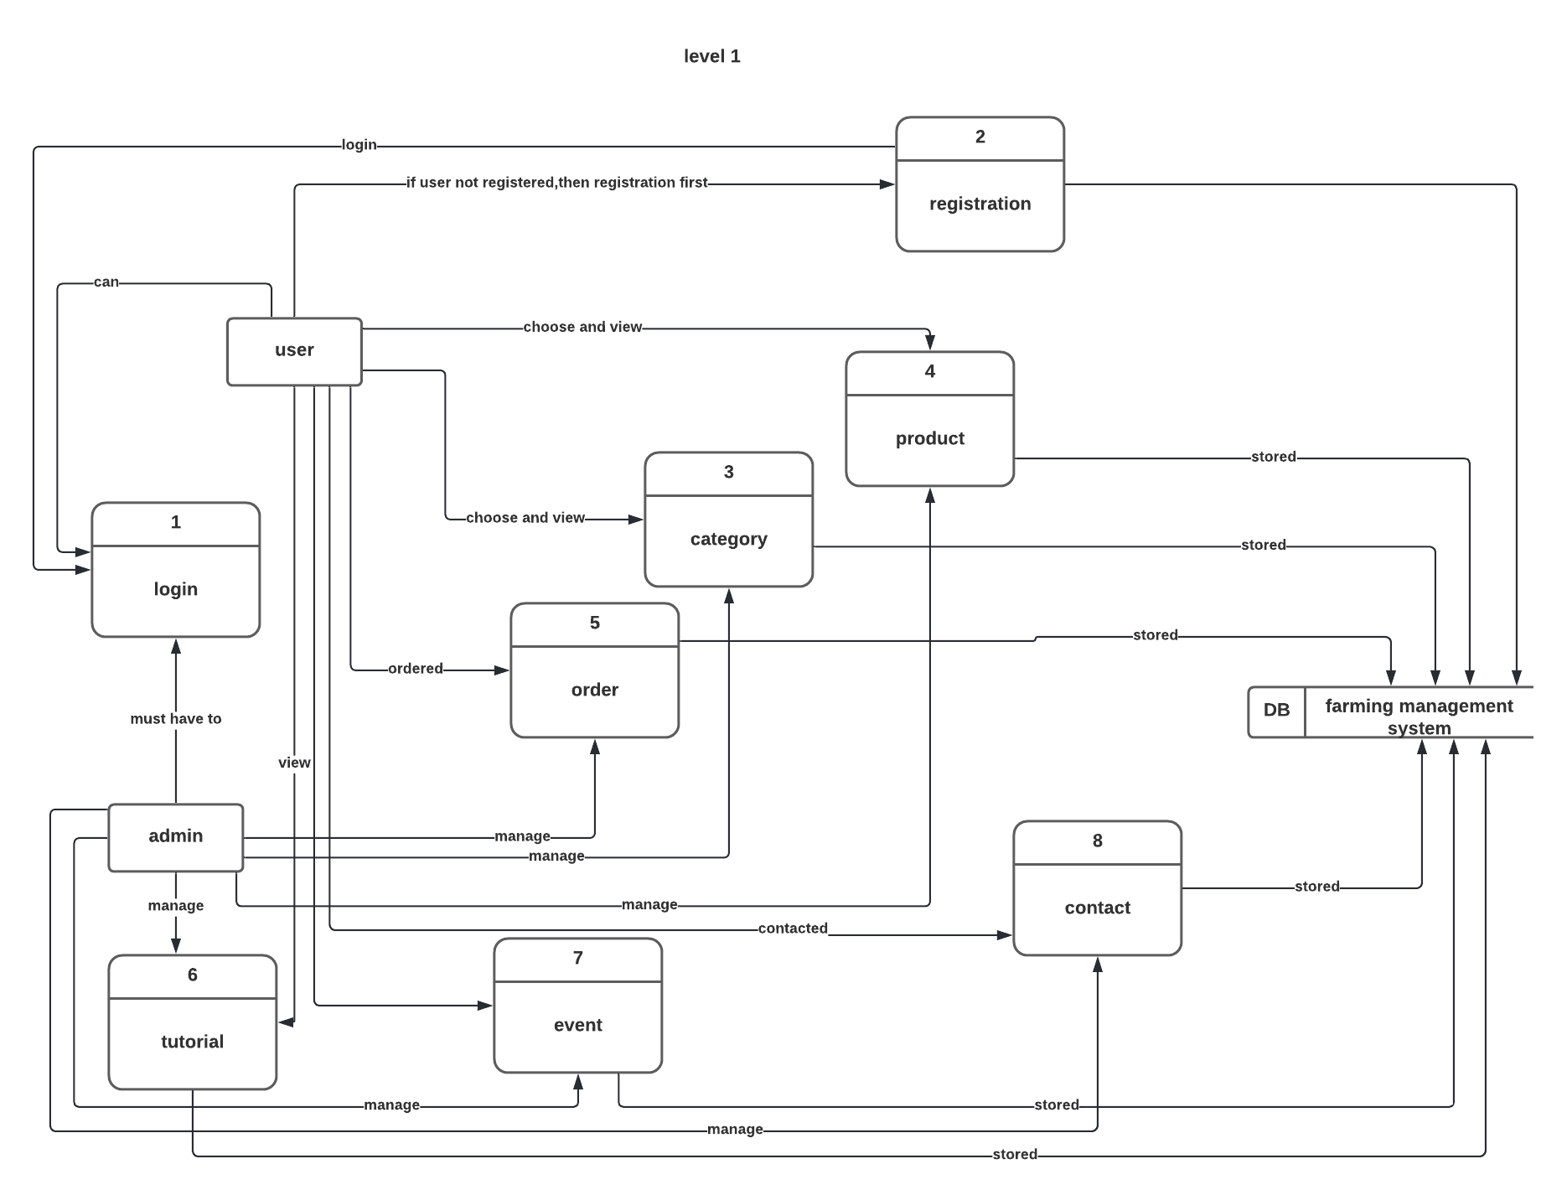
Analysis and Designing Contd…
Level 1 DFD

Slide 38
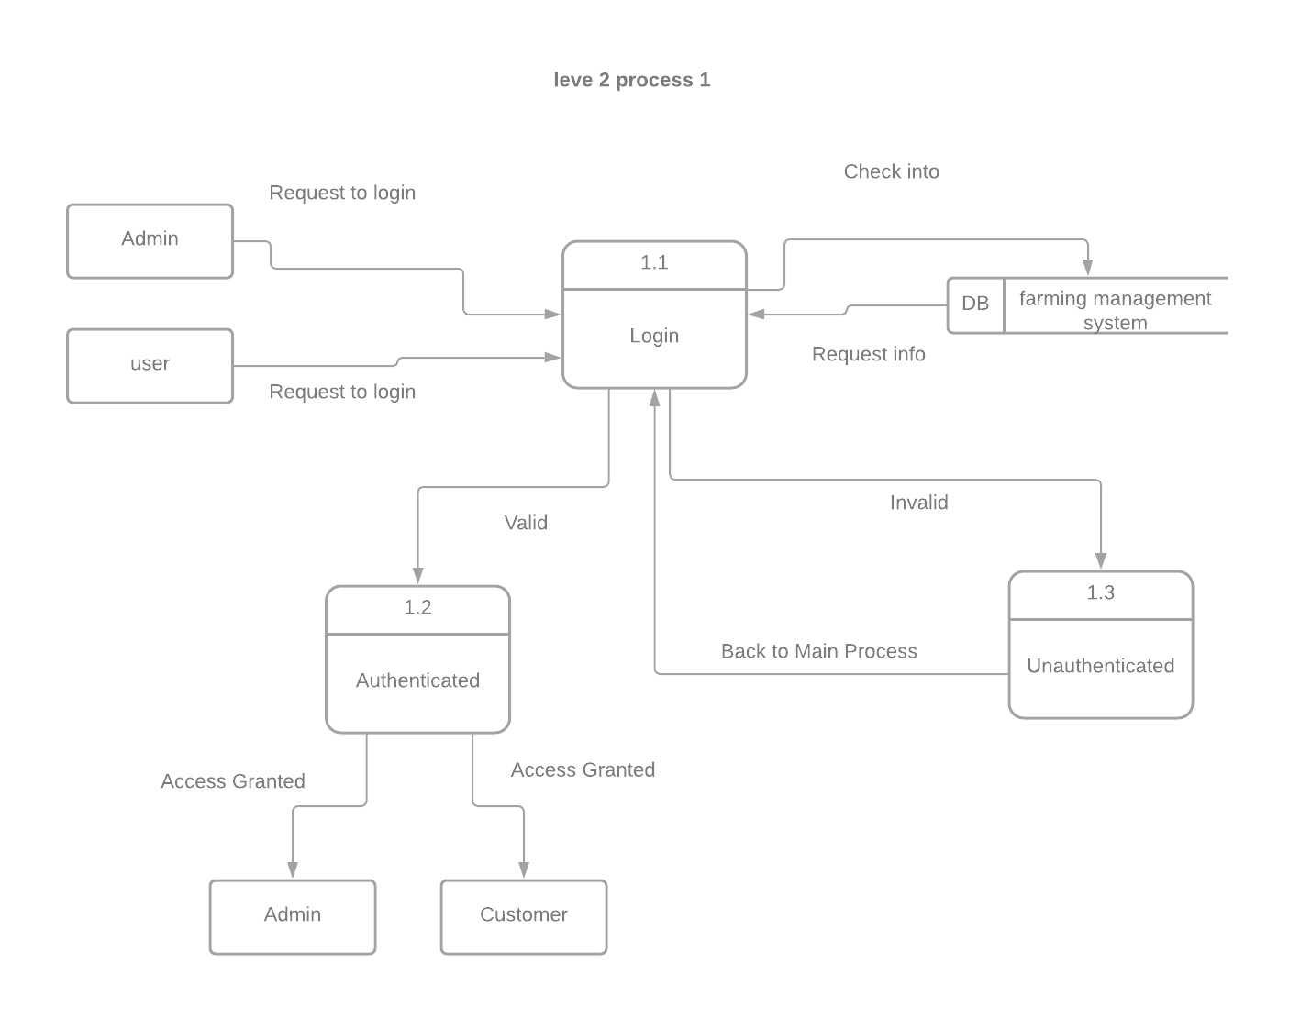
Analysis and Designing Contd…
Level 2 Process 1 DFD

Slide 39
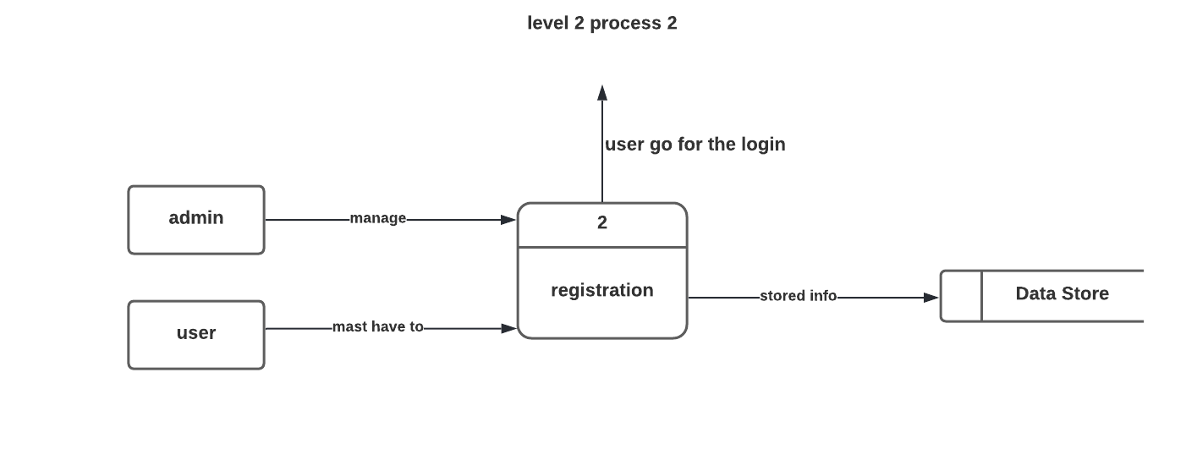
Analysis and Designing Contd…
Level 2 Process 2 DFD

Slide 40
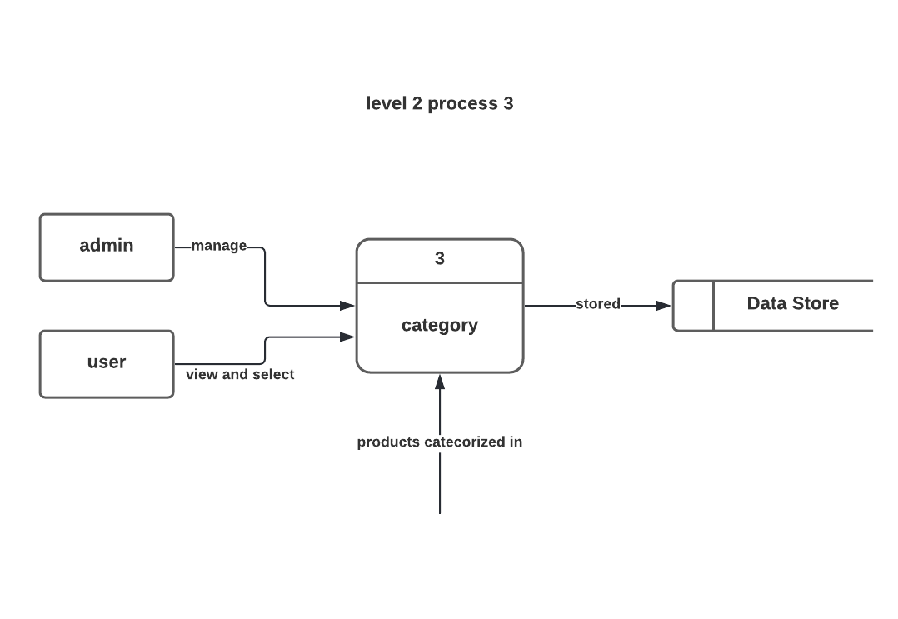
Analysis and Designing Contd…
Level 2 Process 3 DFD

Slide 41
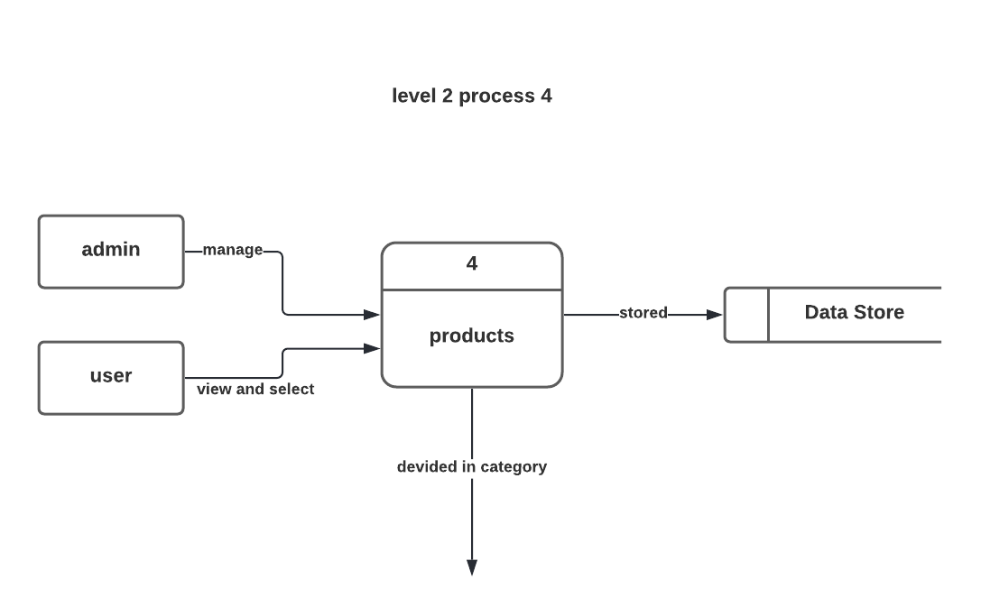
Analysis and Designing Contd…
Level 2 Process 4 DFD

Slide 42
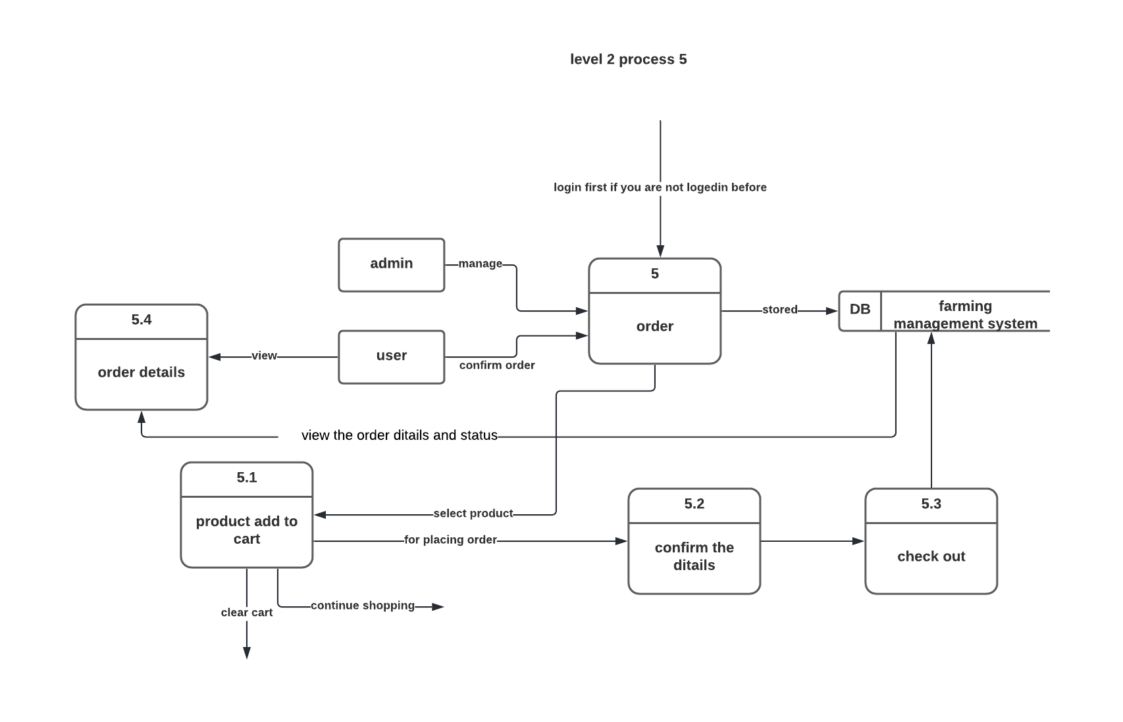
Analysis and Designing Contd…
Level 2 Process 5 DFD

Slide 43
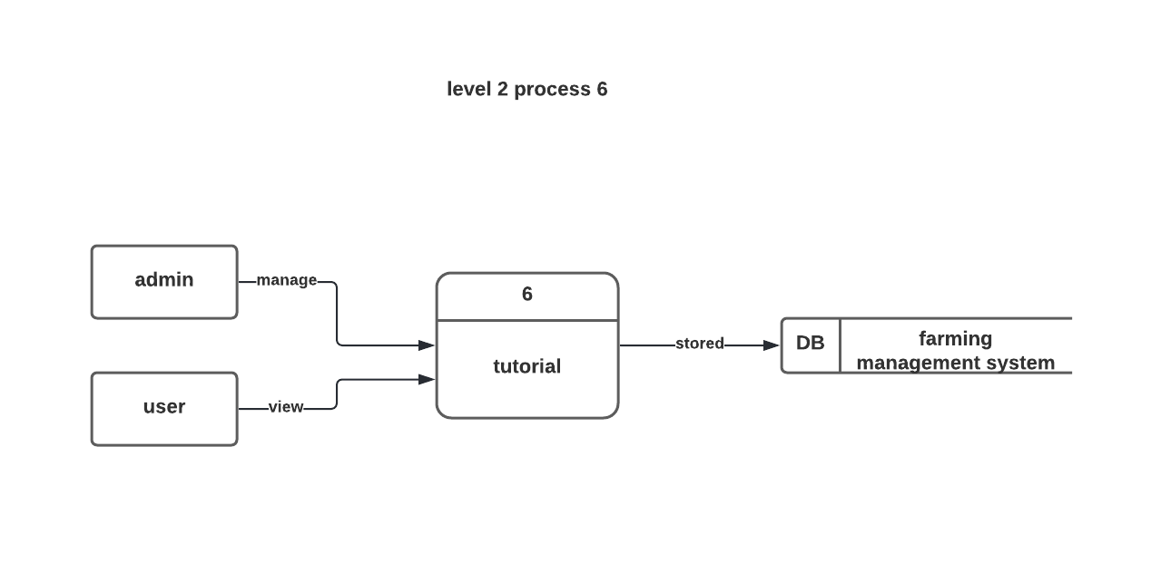
Analysis and Designing Contd…
Level 2 Process 6 DFD

Slide 44
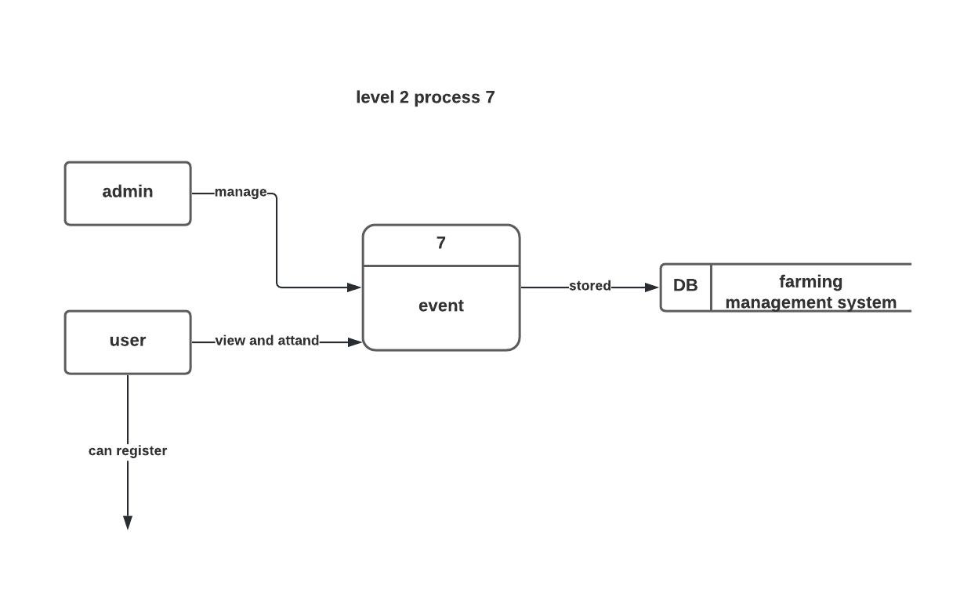
Analysis and Designing Contd…
Level 2 Process 7 DFD

Slide 45
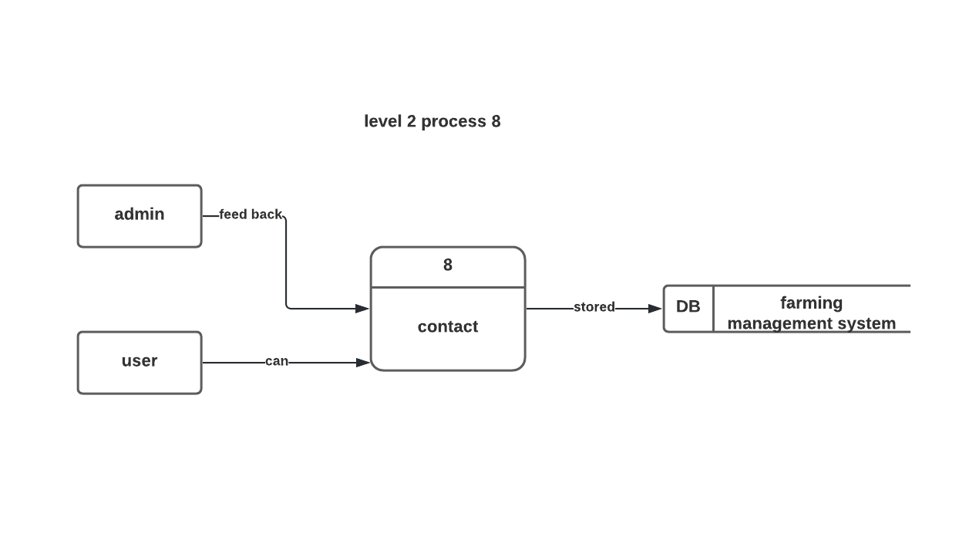
Analysis and Designing Contd…
Level 2 Process 8 DFD

Slide 46
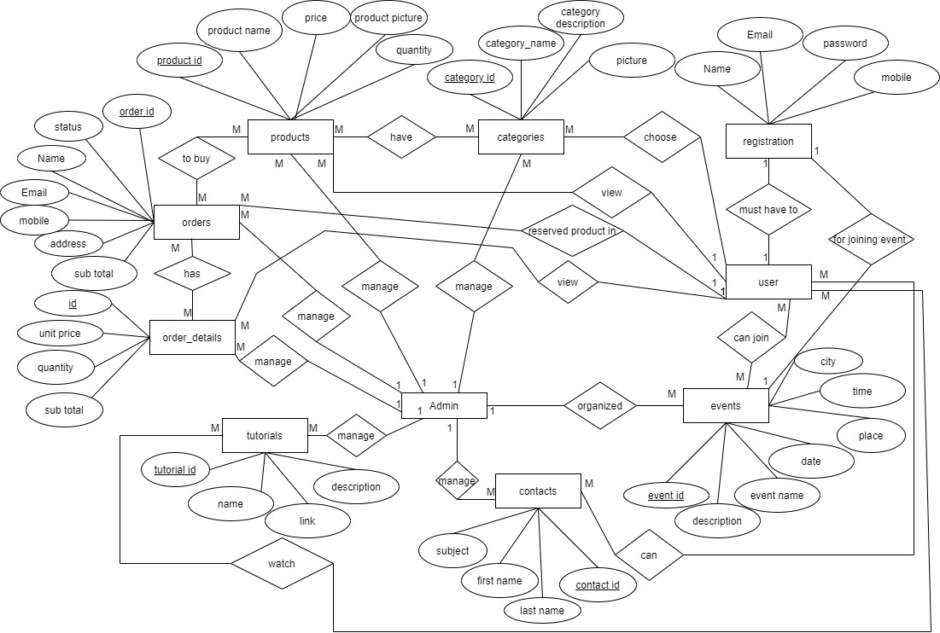
Analysis and Designing Contd…
Entity Relationship Diagram

Slide 47
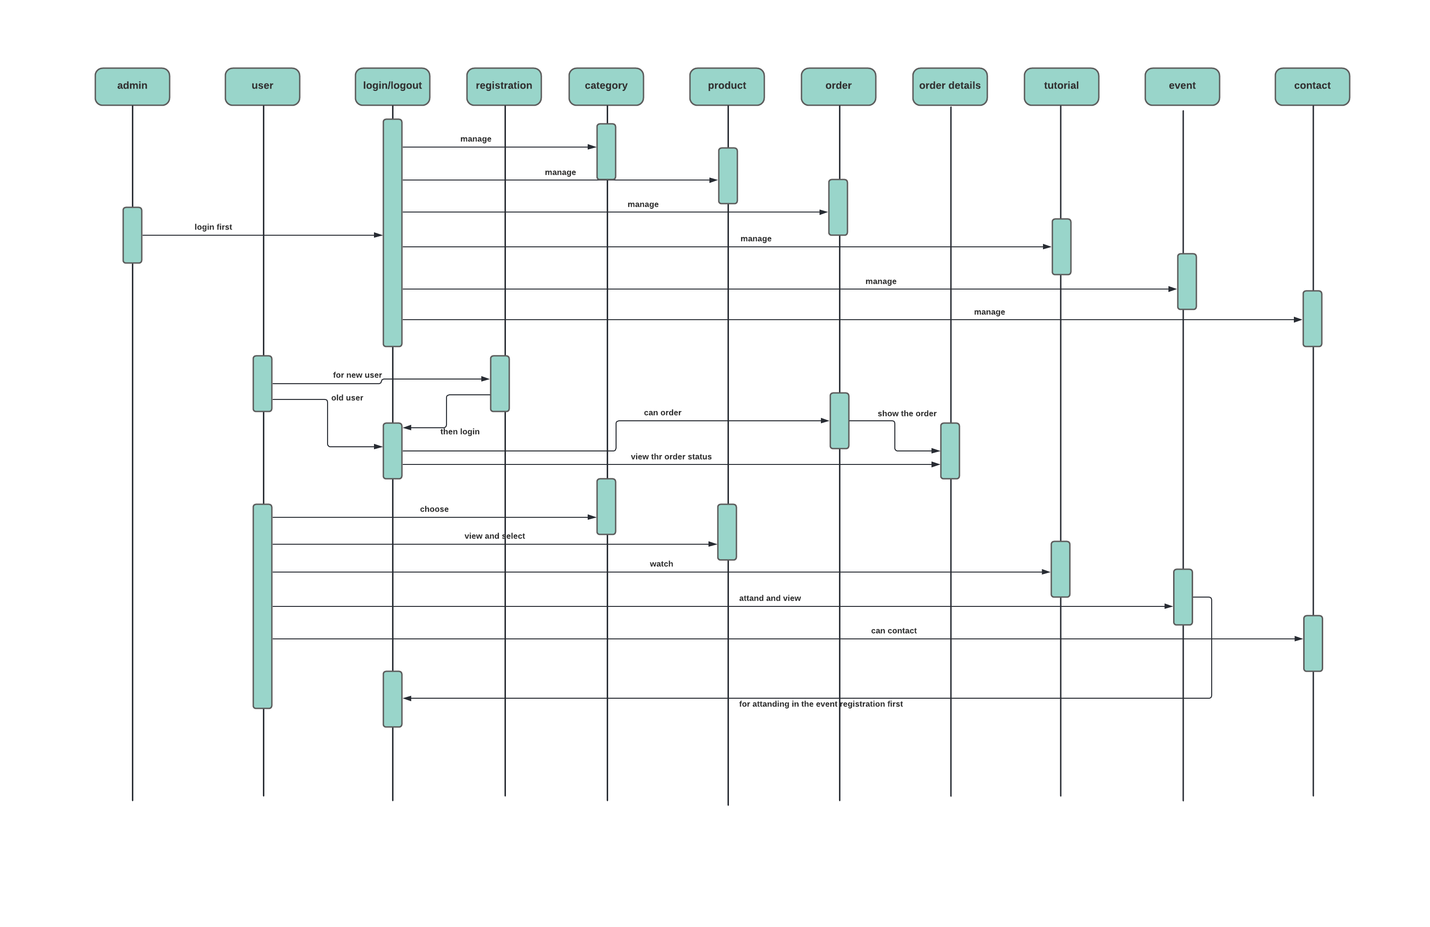
Analysis and Designing Contd…
Sequence Diagram

Slide 48
Project Demonstration

Slide 49

Future Work
In future I would like to work in :
Add online based payment system.
Directly contact with customer from the site.
Working Payment Gateway Integration
Tracking Option

Slide 50
Conclusion
By building this website, I have learned a lot of things. Such as Laravel in depth , Complex query writing and so many.
After the development of this system I am confident enough that I can work on any professional environment and I also learned the following –
Dealing with clients
Collecting requirements from clients
Working under an environment and under pressure

Slide 51


